Slide 1
Punjab Urban Development Mission
Government of Punjab

Slide 2
Urbanization
Urbanization closely associated with growth
Stimulates economic efficiencies
Generates employment
Creates opportunities of entrepreneurship
Major contributor to GDP
Areas of high concentration of population
Areas of high concentration of economic activities
Providers of quality social infrastructure i.e. healthcare, education, recreation, etc.
Providers of physical infrastructure i.e. water supply, sewerage, roads, electricity, etc.

Slide 3
Urbanization
Urbanization despite numerous opportunities pose distinct challenges & problems in terms of:
Unplanned growth & development
Mismatch between supply & demand of basic infrastructure i.e. water supply, sewerage, road network, sanitation, etc.
Acute shortage of housing
Rapid growth of slums
High degree of environmental degradation
Vehicular congestion
Issues of Urban Governance
Issues of urban poverty

Slide 4
Urbanization Scenario-India
India passing through a phase of massive urbanization
Level of urbanization – 31.16% (2011)
Total Population: 1.21 billion (2011) against 1.02 billion (2001)
Projected total population: 1.4 billion by 2030
Urban population: 377 million in 2011 as against 285 million in 2001
Projected Urban population: 600 million by 2030
Number of urban agglomerations : 7935 in 2011 as against 5161 in 2001
Number of census towns increased by 2532 against 242 statutory towns
Number of metro cities: 53 in 2011 as against 35 in 2001
Projected numbers of metro cities: 100 by 2030
Most urbanized state – Goa (62.17%)
Least urbanized state – Himachal Pradesh (10.04%)
*Projections by 12th Five Year Plan Approach Paper

Slide 5
Urbanization Scenario-Punjab
Punjab ranked 8th among states in urbanization
Level of urbanization – 37.49% (2011) against 33.95% (2001)
State population – 27.7 million (2011) against 24.3 million (2001)
Projected total population: 39 million by 2030
Urban population: 10.4 million in 2011 as against 8.3 million in 2001
Projected Urban population: 18.3 million by 2030
Number of urban agglomerations : 217 in 2011 as against 157 in 2001
Largest increase of number of UAs (60) with highest increase in census towns
Number of metro cities: 2 in 2011
Projected numbers of metro cities: 3 by 2030
During last century (1901-2001), state population increased by 3 times whereas urban population increased by 9 times

Slide 6
Urbanization Scenario-Punjab
Punjab for the first time, recorded slower growth rate in total population (13.73% vs. 17.64%), urban population (25.72% vs. 31.80%) and rural population (7.58% vs. 12.18%)
Urban growth rate (25.72%) more than three times of rural growth rate (7.52%)
State economy revolves around agriculture, however contribution of agriculture in State GDP declining.
Contribution of urban area to State GDP – 75%
Urban areas to be major drivers of economy by promoting industry and service sector
Urban areas to be the major generator of future employment
Growth & development of the State closely linked with productivity, sustainability and operational efficiency of urban centers
Urban centers need more focused attention for state growth and development of rural areas

Slide 7
Municipal Structure in Punjab
Nagar Panchyat
Municipal Council – C Class
Population
Municipal Council –B Class
Population
Municipal Council-A Class
Income
Income
Income
Population
Income
Municipal Corporation
Population
Income
5000 -15000
Population
Up to Rs. 1 Crore
15000 - 25000
Up to Rs. 1 Crore
25000 - 50000
Minimum Rs. 1 Crore
50,000 – 3,00,000
Minimum 2 Crore
3 lacs & above
More than Rs. 2 Crore
Total -38
Total - 28
Total - 43
Total - 23
Total – 9
Town Improve-ment Trusts
Total: 28
3 tier municipal structure - corporations, council and nagar panchyats
18 Corporation/A Class Councils have population more than 1 Lac
Remaining 123 Councils / Nagar Panchyats have population less than 1 Lac
Ward committees for cities above 3 lac population (yet to be constituted)
District planning committees
Metropolitan planning committees (yet to be constituted)

Slide 8
Issues in Urban Development in Punjab
Urban growth driven by unauthorized & unplanned development
Mushrooming of unauthorized colonies
Rapid growth of slums – 2.71 Lac families live in slums
High degree of deficiency in service provision and delivery
Absence of master plans for majority of urban settlements
Non involvement of ULBs in the preparation of Master Plans
Lack of financial, technical and human resources with ULBs
High degree of traffic congestion in core areas of cities
Mixing of incompatible land uses – industries mixing with residential areas
Encroachment on public land including roads
Urban poverty – growth of informal sector

Slide 9
Issues in Urban Development in Punjab
Absence of adequate open spaces
Poor operation & management of existing services
Multiplicity of agencies operating at local level
Spirit of 74th constitutional amendment missing
Absence of single legal framework for ULBs
Poor interface between public and ULBs
Poor urban governance

Slide 10
Status of Civic Infrastructure

Slide 11
Status of Civic Infrastructure
Basic Amenities | No. of Towns | >90% | 80-90% | 60-80% | <60% | Average
Water Supply | 141 | 81 | 50 | 5 | 5 | 88%
Sewerage | 141 | 22 | 26 | 24 | 69 | 63%
Roads | 141 | 6 | 34 | 59 | 42 | 66%
Slum Development and Housing | 141 | 0 | 19 | 27 | 95 | 46%
Sewerage Treatment Plant | 141 | N.A. | N.A. | N.A. | N.A. | 38%
Fire Services | 141 | N.A. | N.A. | N.A. | N.A. | 50%

Slide 12
Financial Status of ULBs in Punjab
Rs. In Crores
Sr. No. | ULBs | No. | Receipts | Expenditure | Surplus/Deficit
1. | Municipal Corporations | 9 | 1101.84 | 1147.36 | (-) 45.52
2. | A Class Municipal Council | 23 | 486.34 | 512.26 | (-) 25.92
3. | B Class Municipal Council | 43 | 203.02 | 249.51 | (-) 46.49
4. | C Class Municipal Council & Nagar Panchayats | 66 | 109.94 | 135.19 | (-) 25.25
Total deficit of Rs. 143 Crores

Slide 13
Fund Requirement for 100% Coverage
Basic Amenities | Coverage as on 2012 | Funds Required (in Rs. Crores) for 100% coverage
Water Supply | 88% | 962
Sewerage | 63% | 2667
Sewage Treatment Plant | 38% | 2300
Roads & Parks | 66% | 1470
Slum Development/Housing | 46% | 729
Fire Services | 50% | 500
Total |  | 8628 Crores
Based on the preliminary estimate to bridge the service delivery gap, requirements of funds - Rs. 8628 Crores
Funds to the tune of Rs. 3403 Crores have already been tied up from different agencies leaving a gap of Rs. 5225 Cr.
To develop state of art urban infrastructure and to put urban development on the fast track, State Government proposes to adopt target oriented Mission approach.

Slide 14
Mandate & Delivery Framework
Urbanization Scenario
Municipal Institutions in Punjab
Review of National / State Missions
Punjab Urban Development Mission (PUDM)
PUDM - Institutional Framework
PUDM – Financing Approach
PUDM - Capacity Building
PUDM Road Map - Approach & Strategies
To review the National and
State level best practices
To suggest the institutional framework of PUDM
To suggest funding pattern of PUDM
To incorporate the relevant concerns of various stakeholders
To draft monitoring & review mechanism
To recommend initiatives for capacity building

Slide 15
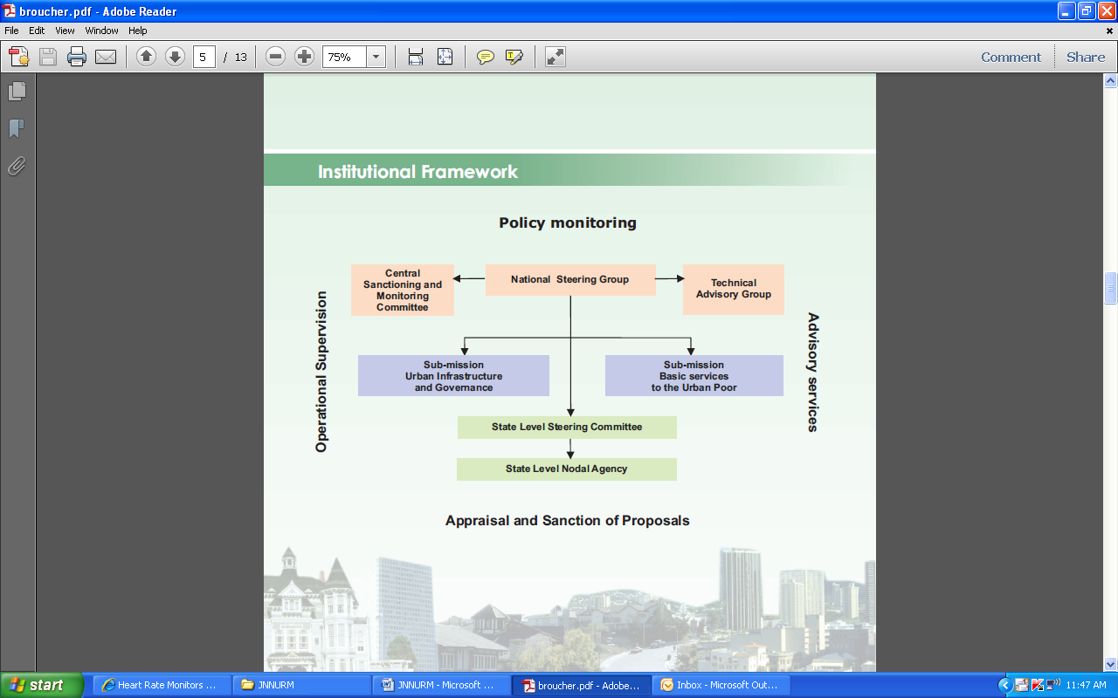
Key National Mission - JNNURM
Reform led urban mission (2005-12) covering 63 towns with objectives:
Integrated development of infrastructure services
Securing linkages between asset and maintenance for sustainability
Accelerating the flow of investment in urban infrastructure
Planned development of cities / peri - urban areas/ outgrowth
Renewal and re-development of inner city areas
Universal availability of urban services including urban poor
Emphasize on State level & Municipal level Reforms

Slide 16
Key National Mission - NRHM
Mission launched in 2005 with 7 year period focuses on:
Providing healthcare to rural population
Raising public spending from 0.9% to 2-3% of GDP
Capacity building of Panchyats to manage health services
Launching health plan for each village through village health committees
Creating a hierarchy of health service at local level, block level and district level
Strengthening of CHC and PHC
Integrating health with drinking water, hygiene and nutrition
Involving NGOs and resource organizations
Improving health information system
Developing capacities for preventive health care

Slide 17
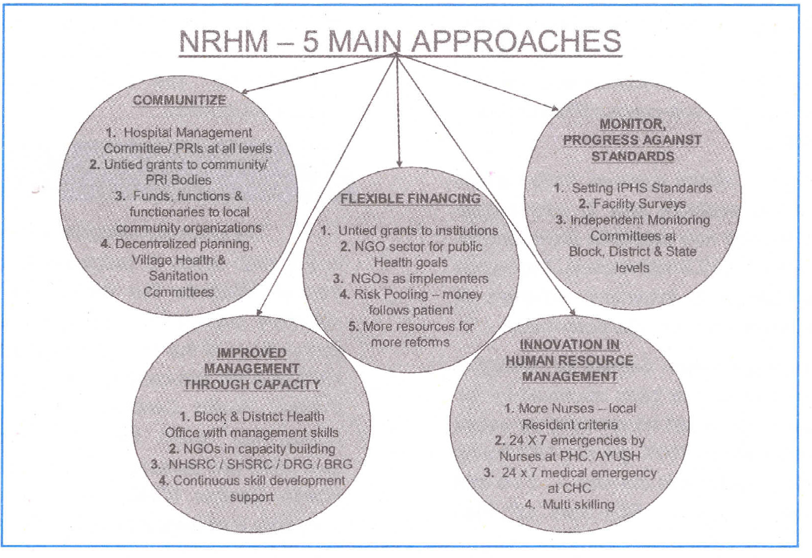
Implementation Framework

Slide 18
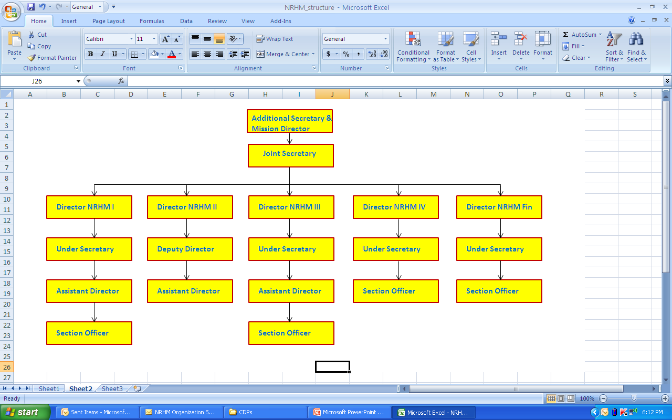
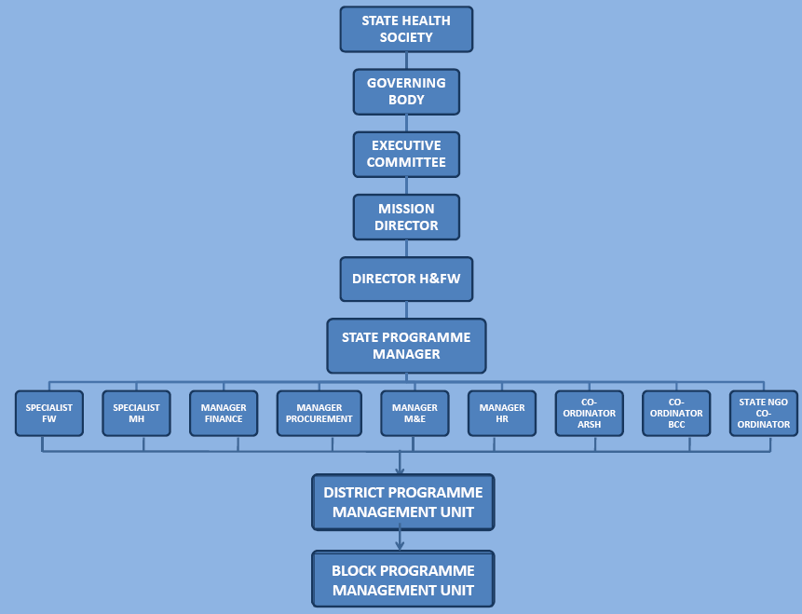
NRHM Structure
Central Level
State Level

Slide 19
Key State Missions - GUDM
Mission launched in 2006 for a period of 7 years, focuses on:
Supporting urban renewal & infrastructure development
To attain better living standards
To create hospitable environment for people to live and work in urban areas
To make cities productive and sustainable
Support to ULBs &
Parastatal Agencies
CDPs & DPRs
Capacity Building
IEC activities
Assessing projects
& seeking
financial assistance
from GoI under
JnNURM
Periodic Reporting
to MoUD/ MoUEPA, GoI
Functions of GUDM
Financial Mgmt.
Managing Grants from GoI & GoG
Managing Revolving Funds
Monitoring Projects &
Reforms
Implementation
Funding ULBs through
grants and/or soft loans

Slide 20
GUDM - Structure
Gujarat Urban Development Mission
Governing Body
Executive
Committee
State Level
Steering Committee
Advisory Group
Advisory Group
State level
Nodal Agency
Ahmedabad, Rajkot, Surat, Vadodara / ULBs

Slide 21
GUDM Achievements
Road
Road development through public participation
Construction of Model Roads – GauravPath, VikasPath & SuvidhaPath across the State
Development of thematic traffic circles.
Water Supply
Water sector accorded highest priority
Highest disbursement of grants for strengthening water supply system
Urban Forestry
Afforestation project prepared for 141 Municipalities.
Creation of 45 Panchvati Vans, 73 Smruti Vans, 58 Nakshatra / Rashi Vans and 2 Navgruh Vans.
Solid Waste Management
Exemplary Performance by ULBs of Gujarat in Solid Waste Management - SC directed other states to follow Gujarat’s Model.
Town Planning Schemes
35 TP Schemes awarded- highest no. of TP Schemes sanctioned per year, so far .
Policy & Reforms
Double-entry Accounting System in 141 Municipalities.
Introduction of Area-based Property Tax.
Process initiated to introduce User Charges.
Awards & Prizes
Monthly Awards introduced to nurture competitive spirit among ULBs
Other Achievements
Encroachment Removal drive launched with public support.
Highest tax recovery against tax demand.
“Nagarotsav” celebrations in ULBs with public, NRI/NRG participation.
Heritage revival movement.

Slide 22
Key State Missions – SPUR, Bihar
State Level Project Steering Committee
Project Management Unit
Urban Governance & Planning
Municipal Infrastructure
Urban Development & Housing Department
Urban Technical Assistance Support Team (UTAST)
Municipal Finance & Procurement
Local Economic Development
Social Development & Poverty Alleviation
Six-year partnership programme (2010-2016) between the Government of Bihar and the United Kingdom's Department for International Development (DFID)
To address lack of urban infrastructure
Building human and financial capital
To increase effectiveness of ULB to access & utilize resources
To improve customer satisfaction

Slide 23
PUDM – Vision & Broad objectives
Promoting planned development of cities including core areas and peripheral growth.
Ensuring integrated development of municipal infrastructure services.
Ensuring availability of basic services to the urban poor.
Accelerating the flow of funds into Urban Infrastructure Services.
Ensuring asset creation and sustainability of projects in long terms.
Developing urban leadership and capacity building of urban local bodies
Identifying, prioritizing, guiding & providing technical support to Urban Local Bodies for project formulation & implementation
Providing financial assistance for identified different projects in Urban Sector
Raising funds from Government of India, Financial Institutions, co-operate and collaborate with national and international agencies, departments of state government.
Launching large scale IEC and awareness programs
Reviewing and monitoring the ongoing projects
“Punjab Urban Development Mission envisions holistic development of the state of Punjab by creating productive, equitable, sustainable, vibrant and responsive cities providing basic amenities of life to all the urban residents including poorest of the poor to lead a dignified life.”

Slide 24
Scope of Mission
Capacity Building of ULBs
Water Supply
Sewerage
Road Network
Solid Waste Management
Sewerage Treatment Plant
Water Treatment Plants
Storm Water Drainage
Street Lighting
Slum Rehabilitation
Urban Transport
Any other civic infrastructure
Functional Domains
Spatial operational area of the Mission would be the notified area of all Urban local bodies and outgrowth existing in the state.
Initial duration of Mission would be for 5 years (2012 -17) with need based extension.
Geography
Duration

Slide 25
PUDM – Functional Strategy
Leveraging Funds
Leveraging the flow of investment in the identified projects & cities
Capacity Building
Monitoring & Review
MIS
Training & Development
Community Participation
Project Management Units
E-governance
Funds to be made available to ULB/ parastatal agencies
City Development Plans
Policies, programmes and strategies of growth and development
Municipal Infrastructure Plan
Integration with future economic growth of the city
Projects
Project Identification
Preparation of DPRs

Slide 26
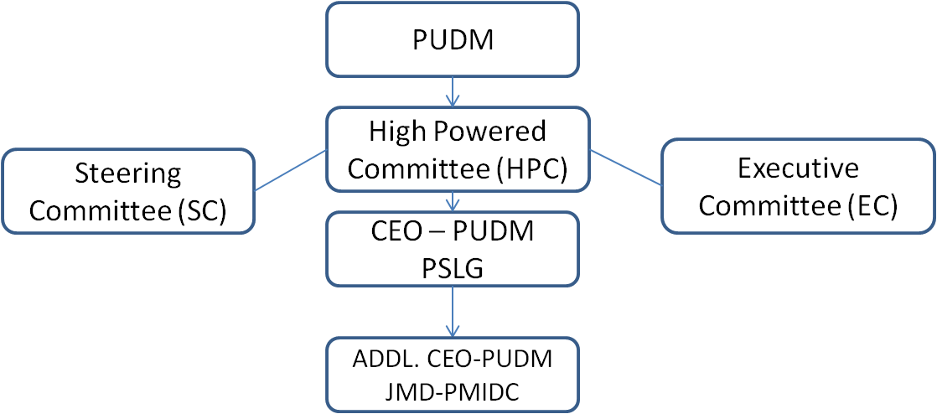
PUDM Institutional Framework
Mission to be named as ‘Punjab Urban Development Mission’
Mission proposed to be registered as Society
Mission to have three Tier structure
High Powered Committee headed by CM, Punjab
Steering Committee headed by Minister for Local Government
Executive Committee headed by the Chief Secretary
PSLG to be the CEO of the Mission
SLG / JMD-PMIDC to be Addl. CEO of the Mission

Slide 27
Functional Framework
General Superintendence
High Powered Committee
Direction
Control
State Level Steering Committee
Project Identification & Recommendation, JNNURM and other Central schemes
Executive Committee
Day-to-day functioning of PUDM

Slide 28
Institutional Framework - HPC
S.No. | Designation | Position
1. | Hon'ble Chief Minister, Punjab | Chairperson
2. | Hon'ble Minister of Local Government, Punjab | Vice Chairpeson
3. | Hon'ble Minister of Housing & Urban Development, Punjab | Member
4. | Hon'ble Minister of Finance, Punjab | Member
5. | Hon'ble Minister of PWD B&R, Punjab | Member
6. | Hon'ble Minister of Water Supply & Sanitation, Punjab | Member
7. | Hon'ble Minister of Revenue, Punjab | Member
8. | Chief Secretary, Government of Punjab | Member
9. | Principal Secretary, Finance Department | Member
10. | Principal Secretary, Revenue Department | Member
11. | Principal Secretary (PWD B&R) | Member
12. | Principal Secretary (Water Supply & Sanitation) | Member
13. | Principal Secretary, Housing & Urban Development | Member
14. | Principal Secretary, Industries | Member
15. | Upto 5 members (experts) to be nominated by the State Government | Member
16. | Principal Secretary, Local Government | Member- Secretary

Slide 29
Institutional Framework - SC
S.No. | Name/ Designation | Position
1. | Minister of Local Government, Punjab | Chair person
2. | Chief Secretary, Punjab | Co-Chairperson
3. | Principal Secretary, Finance Department | Member
4. | Principal Secretary, PWD B&R | Member
5. | Principal Secretary (Water Supply & Sanitation) | Member
6. | Principal Secretary (Housing & Urban Development) | Member
7. | Concerned Mayors / Chairpersons of ULBs | Member
8. | Concerned Municipal Commissioners / Executive Officers | Member
9. | Concerned MPs / MLAs | Member
10. | Managing Director, PIDB | Member
11 | Director, Local Government | Member
12 | Chief Administrator, PUDA / Concerned City Development Authority | Member
13. | Director, Industries | Member
14. | Upto 3 experts to be nominated by the Government | Member
15. | Principal Secretary(Local Government) and Chief Executive Officer, PUDM | Convenor
16. | Joint Managing Director, PMIDC and Addl. CEO, PUDM | Co – Convenor

Slide 30
Institutional Framework - EC
S.No. | Designation | Status
1. | Chief Secretary | Chairperson
2. | Principal Secretary, Local Government | Vice Chairman
3 | Principal Secretary, Finance Department | Member
4. | Principal Secretary, PWD B&R | Member
5. | Principal Secretary (Water Supply & Sanitation) | Member
6. | Principal Secretary (Housing & Urban Development) | Member
7. | Managing Director, Punjab Infrastructure Development Board (PIDB) | Member
8. | Director, Local Government | Member
9. | Chief Administrator, PUDA / Concerned City Development Authority | Member
10. | Upto 3 experts to be nominated by Chairperson | Member
11. | JMD, PMIDC | Convenor

Slide 31
Coverage and Finances
Nine services to be covered initially in the first phase:
Water supply
Sewerage & STP
Urban Roads
Parks
Slum Development & Housing
Fire Services
Solid Waste Management
Street Lighting Being undertaken on PPP
Urban Transport
All 141 ULBs to be covered with 100% area and population coverage
State to be made slum free
Funds requirement placed at Rs. 8,628 Crore
Funds already tied up: Rs. 3,403 Crore
Balance funds required: Rs. 5,225 Crore

Slide 32
Coverage and Finances
Region wise Detail of Total Fund Requirement for Different Sectors
(Rs. In Crores)
Region | Water | Sewerage | Roads | Parks | Slum | Fire | Street light | Total
Amritsar | 171.53 | 1197.71 | 123.69 | 11.56 | 79.31 | 83.33 | 34.87 | 1702.00
Bathinda | 102.56 | 405.73 | 104.55 | 4.43 | 20.50 | 83.33 | 48.30 | 769.40
Ferozepur | 107.64 | 630.81 | 177.95 | 1.53 | 144.07 | 83.33 | 36.58 | 1181.91
Jalandhar | 72.15 | 1021.06 | 296.19 | 11.08 | 104.15 | 83.33 | 81.22 | 1669.18
Ludhiana | 397.92 | 837.25 | 281.23 | 32.01 | 313.07 | 83.33 | 12.10 | 1956.91
Patiala | 110.11 | 874.27 | 409.50 | 16.13 | 68.27 | 83.33 | 23.01 | 1584.62
Total | 961.91 | 4966.83 | 1393.11 | 76.73 | 729.37 | 500.00 | 236.08 | 8864.02
*Street lighting expenditure to be excluded, if taken on PPP.
*O & M cost shall be met by ULBs from their own resources

Slide 33
Coverage & Financing
Existing PMIDF
Funds / Grants for Urban Development
from GoI
PUDM
Activities
Funds / Grants for Urban Development
from GoP
PCDF
Punjab
City Development Fund
Financial Assistance from National /
International Agencies
Contribution by Urban Development /
parastatal agencies
Income from Properties vested into
PUDM by the State Government
Resources Mobilization-
by leveraging market funds
Contribution by ULBs
MP/MLA Local Area Development Scheme

Slide 34
Options for Revenue Generation
Rationalizing Property Tax
ULB
Resources
Land Based Instruments :
Floor Space Index
Accommodation Reservation
Transfer of Development Rights
Infrastructure Transfer of TDR
Land Value Tax
Special Assessment District
Town Planning Schemes
Betterment Charges
Taxing Vacant Urban Lands
Rationalizing User Charges
Levying Professional Tax
Private Financial Markets
PPP

Slide 35
PUDM Implementation Structure
PUDM
Technical Advisory Group
Empanelled Consultants
Support Functions
Core Functions / Central Level
Research,
Training
& Dev.
MIS, IEC
&
Doc.
IT wing
Finance
&
Adm.
Street
Lighting
& Fire
Services
Road &
Parks
Water
Supply
&
Sewerage
Urban
Transport
Urban
Planning
&
Design
Urban
Housing
&
Slum
Urban
Reform
Env.
&
SWM
Punjab Institute of Municipal Development
Project Management Units (Regional Level)
Third Party Inspection
Project Implementation Units (Local ULB Level)

Slide 36
PUDM Functioning Mode
Services of Professionals, Experts & Competent Firms
Selective Govt. Officers on Deputation
Function as a Society
No liability after dissolution
5 Years ( Beginning from 2012-13)

Slide 37
Capacity Building - MIS
Setting up of dedicated cell within PUDM covering all ULBs involving:
Generation, collection, analyzing and interpreting data
Project based information for constant project monitoring
Monitoring Income & expenditure
Promoting accountability & efficiency
Cost effectiveness
Resource management
Sharing good practices
Faster communication between stakeholders
Avoids duplication of work
Faster service delivery

Slide 38
Capacity Building – Training & Development
Creation of Punjab Institute of Municipal Development for:
Promoting research & development
Training manpower
Capacity building
Facilitating reforms
Urban governance
Financial Management
Urban Planning
Evolving manuals & procedures
Service level benchmarking
Sharing & promoting good practices
Project planning & management
IT applications
E-governance

Slide 39
Capacity Building – Urban Mapping
Creating a dedicated urban mapping unit within PUDM for
preparing maps of areas falling under ULBs and surroundings for:
Promoting planned development
Preparing master plans / development plans
Preparing development / town planning schemes
Rationalizing land use pattern
Infrastructure development
Rationalizing the property tax
Efficient traffic & transportation
Creating urban data banks and land records
Optimum utilization of Government land chunks
Rationalizing equitable distribution of urban infrastructure

Slide 40
Relevant Stakeholders
Urban Development Agencies i.e. PUDA, GLADA, etc.
Punjab Municipal
Infrastructure
Development
Corporation (PMIDC)
Department of Local
Government
Relevant Stakeholders in
Urban Development
State Urban Development Agency (SUDA)
Punjab Water Supply &
Sewerage Board (PWSSB)
Improvement Trusts

Slide 41
Relevant Stakeholders’ Concerns
Stakeholder | Proposed Role
Department of Local Govt. | To work in close coordination with PUDM To support, aid, advise and assist PUDM for achieving mission objectives
PUDM | Umbrella organization for urban infrastructure Convergence of all Institutions, Resources, Central/State funded schemes Policy, planning & guidelines Defining agenda and targets
PMIDC | To manage financial resources including Punjab City Development Fund To regulate financial component of the infrastructure projects To raise financial resources from market
PWSSB | To continue discharging functions related to formulation & preparation of schemes for water supply, sewerage, STPs and storm water drainage To act as technical arm of PUDM
Improvement Trusts | To act as technical arm of ULBs for urban planning & development and real estate development To act as providers of infrastructure development at the local level
SUDA | SUDA to be merged with all schemes & functions transferred to PUDM
Development Authorities | To work in close coordination with PUDM in the areas of urban infrastructure at the ULB level To make available funds collected through EDC for creating city level infrastructure

Slide 42
We look forward to your suggestions………

